Slide 1
Digital Portfolio
STUDENT NAME: PAUL EBANEZAR J REGISTER NO AND NMID:2428F0065\ 24986BB2F0F72FABAD747802ECB4C203 DEPARTMENT: 2ND BSC CS (AI)
COLLEGE: PPG COLLEGE OF ARTS AND SCIENCE /BHARATHIYAR UNIVERSITY

Slide 2
PROJECT TITLE
SIMPLE PORTFOLIO

Slide 3


AGENDA
Problem Statement
Project Overview
End Users
Tools and Technologies
Portfolio design and Layout
Features and Functionality
Results and Screenshots
Conclusion
Github Link
3/21/2024 Annual Review

Slide 4

PROBLEM STATEMENT
This section clearly defines the issue or challenge your project is trying to fix. It answers the question: Why is this project needed?
Describe the current situation or gap.
Explain the difficulties people face without your solution.
Make it clear and focused.
Example:
Many freelancers do not have an easy way to present their skills and past work professionally. Without a portfolio, it’s hard to attract clients or employers. Existing solutions are either too complex or expensive.

Slide 5

PROJECT OVERVIEW
Here, you provide a brief but complete summary of your project. It explains what the project is, what it does, and how it addresses the problem you stated.
Mention the main goal of the project.
Highlight key parts or modules of the project.
Keep it simple but informative.
Example:
This project is a personal portfolio website built to showcase skills, projects, and contact information. It is designed to be easy to customize, mobile-friendly, and visually appealing.

Slide 6

WHO ARE THE END USERS?
Identify the people or groups who will use or benefit from your project.
Think about their needs, background, and how they interact with your project.
Include specific types of users if possible (age, profession, tech level).
Example:
The end users are freelancers, students, and job seekers who want to create an online presence without needing
advanced technical knowledge.

Slide 7

TOOLS AND TECHNIQUES
List all the software, languages, libraries, and platforms you used to build your project. This shows your technical skills and the environment in which your project runs.
Include frontend tools (like HTML, CSS, JS).
Include backend or database if used.
Mention any frameworks, APIs, or design tools.
Also mention version control (like Git/GitHub).
Example:
The project uses HTML5 and CSS3 for structure and styling, JavaScript for interactivity, and Bootstrap for responsive design. Code management was done using Git and hosted on GitHub.

Slide 8
POTFOLIO DESIGN AND LAYOUT
Explain how your project or portfolio looks visually and how it is structured.
Describe the overall style (modern, minimalist, colorful).
Mention the layout of pages or sections (homepage, about, projects, contact).
Talk about user experience (navigation ease, responsiveness to
devices).
Mention any unique design elements (animations, color schemes).
Example:
The portfolio uses a clean, professional design with a fixed navigation bar. It has sections for introduction, skills, projects, and contact. The layout is fully responsive, adapting to
phones, tablets, and desktops.

Slide 9
FEATURES AND FUNCTIONALITY
List and explain the important features your project includes and how they work.
Describe what users can do.
Mention interactive elements.
Highlight anything that makes your project stand out.
Example:
Features include a responsive project gallery with images and descriptions, a contact form with input validation, smooth scrolling animations, and a dark mode toggle for better accessibility.

Slide 10
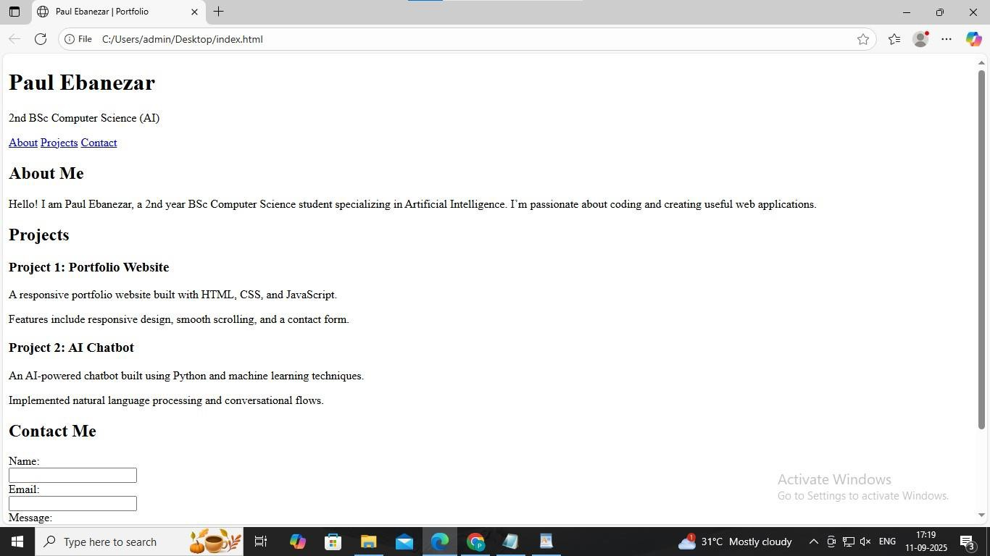

RESULTS AND SCREENSHOTS
3/21/2024 Annual Review

Slide 11
CONCLUSION
Summarize your experience and what you learned from the project.
Reflect on challenges and how you overcame them.
Mention skills you improved.
Talk about future improvements or potential uses of your project.
Example:
This project helped me enhance my skills in web development, especially in responsive design and JavaScript. In the future, I plan to add backend integration for dynamic content management.

